Slide 1
AI VILLAGE
Exploring AI interactions and dynamics in a simulated village
GROUP 1
311 - Advaith Arvind
320 - Arjun G Ravi
329 - Govind Sarath
Project guide: Dr. Subu Surendran

Slide 2
CONTENTS
Introduction
Literature Survey
Desired Impact
Objective
Design
Methodology
Result
Conclusion
Reference

Slide 3
INTRODUCTION
Our goal involves crafting a virtual village using Pygame, placing full authority in the hands of autonomous AI agents. The agents will be able manipulate the world around it, which will inturn affect other AI agents. We intend to create a village where the AI agents coexist. We also intend to constantly monitor the relationship between the AI agents.

Slide 4
LITERATURE SURVEY
The primary research papers that aided the project are
Generative Agents: Interactive Simulacra of Human Behavior
Inner Monologue: Embodied Reasoning through Planning with Language models
Improving Factuality and Reasoning in Models through Multiagent Debate
Character-LLM: A Trainable Agent for Role-Playing
Chain of Thought Prompting Elicits Reasoning in Large Language
AI-Based Conversational Agents: A Scoping Review From Technologies to Future Directions

Slide 5
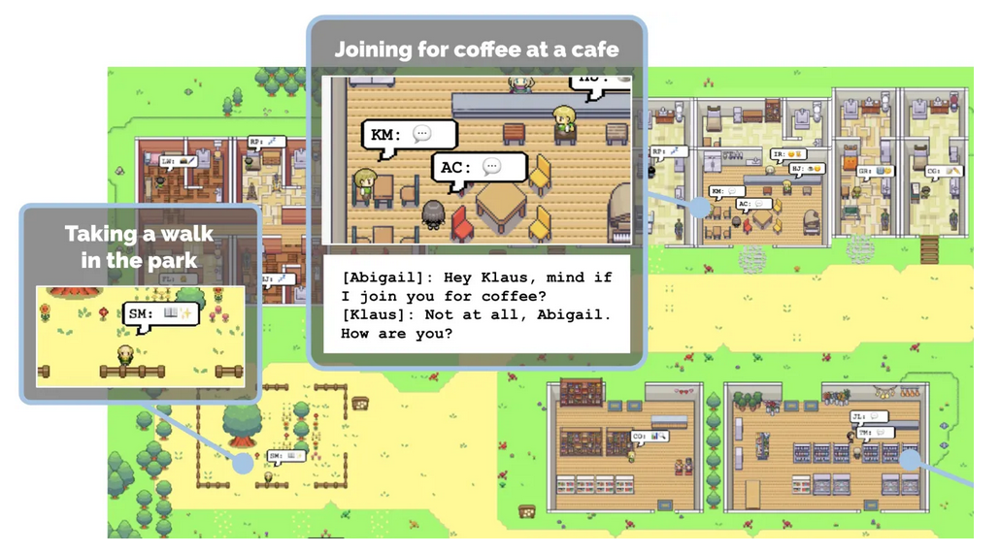
Generative Agents: Interactive Simulacra of Human Behavior
This is the primary paper that introduced the idea of AI agent simulation with large language models.
The paper creates a virtual AI village where AI agents live together in harmony.
The paper talks about how the AI agents are able to organise a party, by communicating with fellow agents.
Joon Sung Park, Joseph C. O’Brien, Carrie J. Cai, Meredith Ringel Morris, Percy Liang, and Michael S. Bernstein. 2023.
Generative Agents: Interactive Simulacra of Human Behavior. In ACM, New York, NY, USA.

Slide 6
2. Inner Monologue: Embodied Reasoning through Planning with Language Models
This paper focuses on giving LLMs an ‘Inner Monologue’.
It is to investigate to what extent LLMs used in embodied contexts can reason over sources of feedback provided through natural language when additional training is not provided.
The inner monologue allows the LLMs to more richly process and plan robotic control scenarios.
Huang, W., Xia, F., Xiao, T., Chan, H., Liang, J., Florence, P.R., Zeng, A., Tompson, J., Mordatch, I., Chebotar, Y., Sermanet, P., Brown, N., Jackson, T., Luu, L., Levine, S., Hausman, K., & Ichter, B. (2022). Inner Monologue: Embodied Reasoning through Planning with Language Models. Conference on Robot Learning.

Slide 7
3. Improving Factuality and Reasoning in Models through Multiagent Debate
This paper presents a complementary approach to improve language responses where multiple language model instances propose and debate their individual responses and reasoning processes over multiple rounds to arrive at a common final answer.
The findings indicate that this approach significantly enhances mathematical and strategic reasoning across a number of tasks.
Shao, Y., Li, L., Dai, J., & Qiu, X. (2023). Character-LLM: A Trainable Agent for Role-Playing. ArXiv, abs/2310.10158.

Slide 8
4. Character-LLM: A Trainable Agent for Role-Playing
The paper addresses an intriguing subject of how characters can be simulated using LMs.
The authors devise a novel methodology and playground for making progress on this that allows them to train agents that they then evaluate for their memories/experiences.
The paper creates a new LLM (Character LLM) which is fine tuned to behave just like a human being.
Joon Sung Park, Joseph C. O’Brien, Carrie J. Cai, Meredith Ringel Morris, Percy Liang, and Michael S. Bernstein. 2023.
Generative Agents: Interactive Simulacra of Human Behavior. In ACM, New York, NY, USA.

Slide 9
5. Chain of Thought Prompting Elicits Reasoning in Large Language
Chain of thought prompting enables models to generate intermediate reasoning steps to help solve multi-step arithmetic, commonsense, and symbolic reasoning tasks.
It shows us how much simple logical analysis of LLMs can make to the output.
We are planning to implement such a chain of thought prompting into our AI agents.
Wei, J., Wang, X., Schuurmans, D., Bosma, M., Chi, E.H., Xia, F., Le, Q., & Zhou, D. (2022). Chain of Thought Prompting Elicits Reasoning in Large Language Models. ArXiv, abs/2201.11903.

Slide 10
6. AI-Based Conversational Agents: A Scoping Review From Technologies to Future Directions
This paper studies the impact of artificial intelligence on human-machine interaction, particularly through conversational AI driven by machine learning, deep learning, and natural language processing.
Furthermore, modern conversational agents are designed to simulate human behavior by incorporating emotional, sentimental, and affective nuances.
S. Kusal, S. Patil, J. Choudrie, K. Kotecha, S. Mishra and A. Abraham, "AI-Based Conversational Agents: A Scoping Review From Technologies to Future directions," in IEEE Access, vol. 10, pp. 92337-92356, 2022, doi: 10.1109/ACCESS.2022.3201144.

Slide 11
DESIRED IMPACTS
Generate novel insights into AI behavior and social dynamics
Advocate for conscientious AI deployment and collaboration
Highlight pressing ethical concerns surrounding AI behavior and autonomy
Uncover previously unidentified patterns and tendencies in AI interactions
Validate existing theories related to multi-agent coordination and cooperation
Study human societies through observing and analyzing AI agent interactions.

Slide 12
OBJECTIVE
The aim of this project is to explore and analyze the behaviors, interactions, and emerging relationship dynamics among artificial intelligence (AI) agents within a simulated village environment. We also aim to learn about human societies through observing and analyzing AI agent interactions.

Slide 13
Design
Village Environment
Adding AI-agents to the village
SchedulerAI
ConversationAI
Integrating Scheduler AI and Conversation AI into the Village

Slide 14
1. Village Environment
The Village Environment is a crucial component of the AI Village project, serving as the virtual world where the AI agents reside and interact.
This environment was created using Pygame, a popular Python library for game development.
To enhance the visual appeal and functionality of the village, we utilized Libresprite, a powerful tool for creating and managing sprites.

Slide 15
PEAS Analysis
Performance: The 'energy' value for each AI agent.
Environment: The environment is the village simulated using pygame.
Actuators: The environment is affected by the output of each (LLM) AI agent.
Sensors: The prompt received by each LLM, acts as the sensor to observe the environment.

Slide 16
2. Adding AI-agents to the village
The AI Village project takes a significant step forward with the introduction of villagers, who are AI agents, into the Pygame Village Environment.
The villager's schedule is generated by the SchedulerAI.
The ConversationAI plays a crucial role in facilitating interactions between villagers.
The animation and art aspects of the villagers are handled by Libresprite which provides a visually appealing and engaging experience.

Slide 17
3. SchedulerAI
The SchedulerAI is a pivotal component of the village, responsible for generating personalized schedules for each villager.
This intelligent system leverages the capabilities of LLaMA3.
To create these schedules, the SchedulerAI draws upon the base character and memory of each villager.
By combining the villager's base character and memory, the SchedulerAI can generate schedules that are both realistic and engaging.

Slide 18
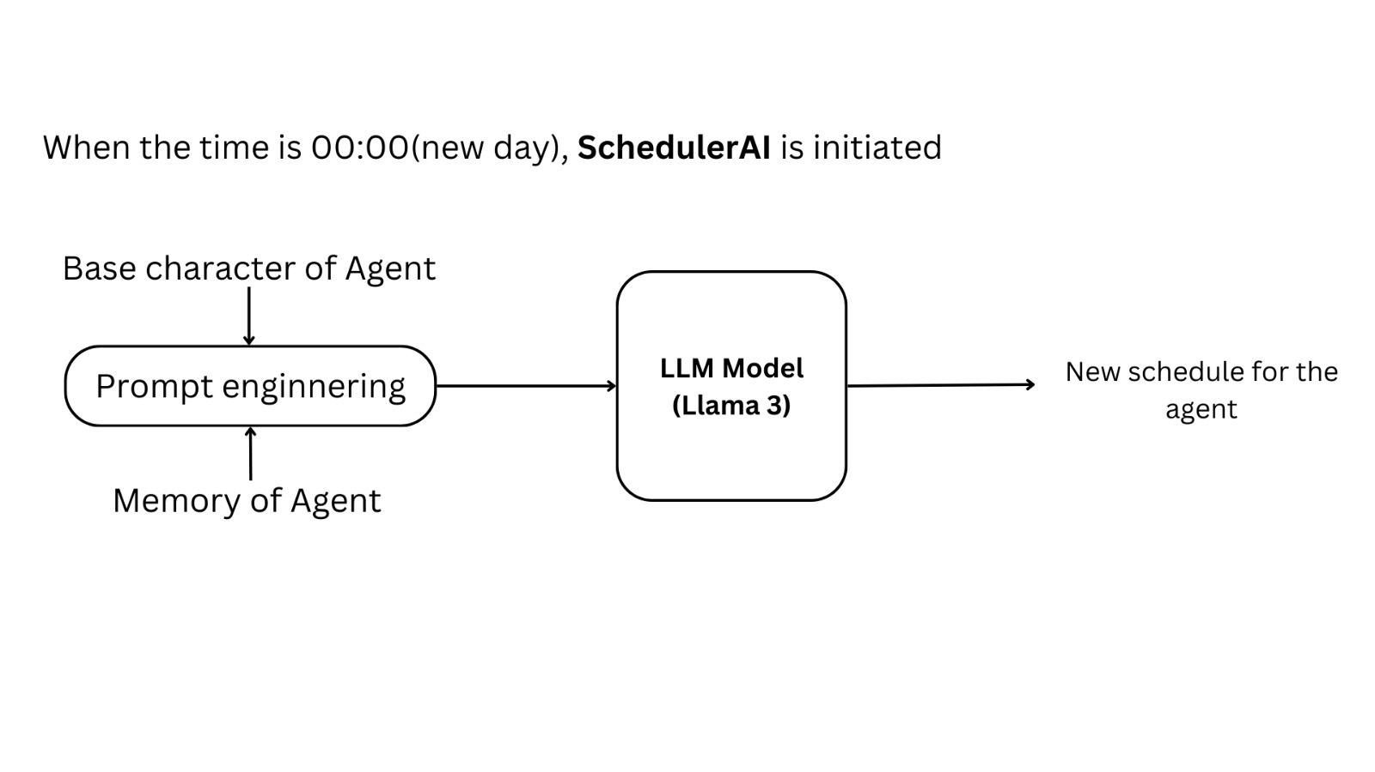

3. SchedulerAI

Slide 19
4. ConversationAI
The ConversationAI is a sophisticated component of the AI Village project, responsible for facilitating conversations between two agents when they come within a fixed proximity of each other.
This intelligent system utilizes the capabilities of LLaMA3.
When two agents come within a predetermined distance of each other, the ConversationAI is triggered, initiating a conversation between the agents.

Slide 20
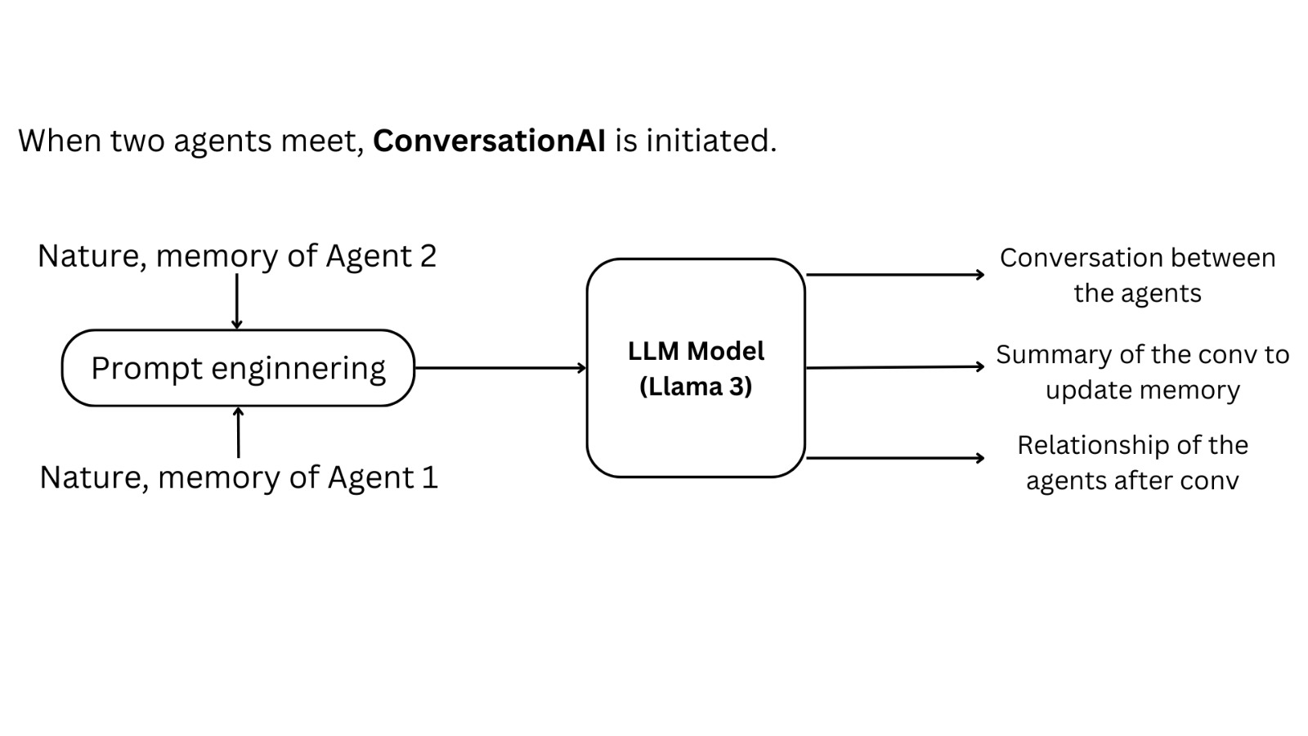
4. ConversationAI

Slide 21
5. Integrating SchedulerAI and ConversationAI into the Village
The integration of the SchedulerAI and ConversationAI into the Pygame Village with Agents is a crucial aspect of the AI Village project.
This integration enables the agents to navigate the virtual world, interact with each other, and adapt to changes in their schedules and relationships.
The agents utilize the SchedulerAI to manage their daily routines, which are represented as personalized timetables.

Slide 22
5. Integrating SchedulerAI and ConversationAI into the Village
To facilitate movement between locations, the agents employ the A* algorithm, a popular pathfinding technique that enables them to navigate the village efficiently.
When two agents encounter each other, the ConversationAI is triggered, generating a conversation between them. This interaction can have a profound impact on the agents' relationships, energy levels, and even their schedules.

Slide 23
5. Integrating SchedulerAI and ConversationAI into the Village
The integration of the SchedulerAI and ConversationAI enables the agents to respond dynamically to changes in their environment and relationships.
This dynamic interplay between the SchedulerAI, ConversationAI, and agent movements brings the virtual world to life, simulating the complexities and nuances of real-life social interactions.

Slide 24
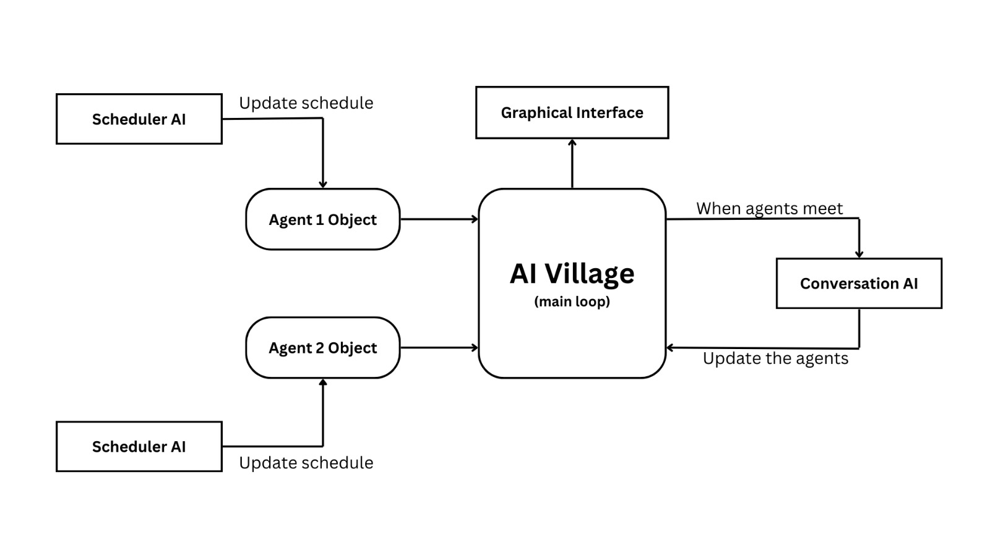
5. Integrating SchedulerAI and ConversationAI into the Village

Slide 25
METHODOLOGY
AI Agent Structure
SchedulerAI
ConversationAI
Motion of the agents - A* Algorithm
Integration of AI into Village

Slide 26
1) AI Agent Structure
The AI agents (villagers) are implemented as a Python class with the following attributes:
class AI-Agent
1. Sprites (villager images and animations)
2. Name
3. Base Personality
4. Energy level
5. Relationship (implemented as a dictionary with every other agent as keys and the corresponding relationship as values.
6. Schedule (current schedule)
7. Memory

Slide 27
2) SchedulerAI
Start
Read the basic character and memory of the agent from the agent’s object
Prompt the LLM to give the schedule given the above details in the correct format
Use regular expression to extract the exact schedule from the LLM’s output
Return the extracted schedule
Stop

Slide 28
3) ConversationAI
The ConversationAI is responsible for generating the conversation between two agents.
It also updates the memory of both the agents with the conversation and the relationship value between the agents.
The ConversationAI will run in a thread along with the program.

Slide 29
3) ConversationAI
Start
Read the basic character, relationship, and memory of both the agent from the agents’ object
Prompt the LLM to generate a conversation between these two agents, given their base details and memory. Also, ask the LLM to generate a summary of the conversation and the relationship after the conversation between the two agents.
Use regular expressions to extract the relevant conversation to print.
Update the memory of both agents with the new summary.
Update the relationship value between the agents
Stop

Slide 30
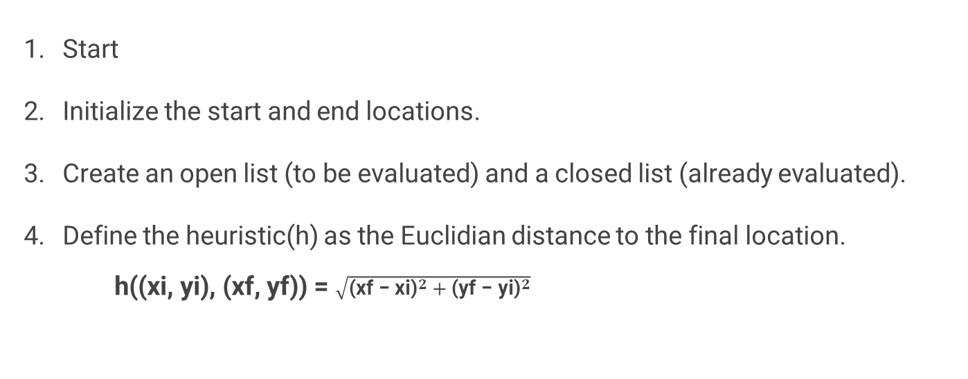
4) Motion of the agents - A* Algorithm
Start
Initialize the start and end locations.
Create an open list (to be evaluated) and a closed list (already evaluated).
Define the heuristic(h) as the Euclidian distance to the final location.
h((xi, yi), (xf, yf)) = $\sqrt{{\text{(}\text{xf}\text{ − }\text{xi}\text{)}}^{2} + {\text{(}\text{y}\text{f}\text{ − }\text{y}\text{i}\text{)}}^{2}}$

Slide 31
4) Motion of the agents - A* Algorithm
While the agent has not reached the end location, repeat
Select the node with the lowest f-cost (f = g + h) from the open list.
Move the current node from the open list to the closed list.
if current_location == final_location
return the path to the agent
else
if the neighbor is not walkable or is on the closed list
Do nothing
Calculate the g and h values for the current location
if the neighbor is not in the open list, add it to the open list and update its parent
else:
Update neighbor’s h and g value, if the current cost is lower than the previous cost
end while
Stop

Slide 32
5) Integration of AI into Village
This is the pivotal part of the project where we use ConversationAI and SchedulerAI to control the actions performed by the agents living in the village.
Algorithm:
Start
Initialize the required number of AI agents
Using SchedulerAI(), create an initial schedule for each of the agents

Slide 33
5) Integration of AI into Village
while the village is running do
if time==00:00 // New day
SchedulerAI()
Update the new schedule for all AI agents
for each agent
Perform the action to be performed at the current time
if an agent has to reach another location
A_star()
if another agent is present within 5 blocks
Create a new thread
ConversationAI()
Update memory, relationship
if the conversation leads to a rescheduling
Update the previous conversation with SchedulerAI()
Display the current village state in the Graphical Interface.
end while
Stop

Slide 34
Results
The AI Village project has successfully created a simulated village where autonomous agents, controlled by Large Language Models (LLMs), interact and coexist. The agents have developed their own social dynamics, relationships, and behaviors, showcasing the potential for complex AI systems.
Notable events have occurred in the village, including a heated debate between two agents regarding their work ethics, which eventually leads to a massive fight and the formation of a strong bond between the two agents. These events highlight the importance of social dynamics, emotional intelligence, and adaptability in AI systems.

Slide 35
CONCLUSION
To conclude, our AI Village project demonstrates great promise in advancing understanding of AI behavior and social dynamics within intricate environments. Its emphasis on responsible AI integration, collaborative coexistence, and continuous relationship assessment offers unique opportunities for exploring novel implications and consequences arising from AI presence among us. Ultimately, we hope to inspire informed discussions regarding AI ethics, governance, and societal impact.

Slide 36
REFERENCES
[1] Joon Sung Park, Joseph C. O’Brien, Carrie J. Cai, Meredith Ringel Morris, Percy Liang, and Michael S. Bernstein. 2023. Generative Agents: Interactive Simulacra of Human Behavior. In ACM, New York, NY, USA.
[2] Huang, W., Xia, F., Xiao, T., Chan, H., Liang, J., Florence, P.R., Zeng, A., Tompson, J., Mordatch, I., Chebotar, Y., Sermanet, P., Brown, N., Jackson, T., Luu, L., Levine, S., Hausman, K., & Ichter, B. (2022). Inner Monologue: Embodied Reasoning through Planning with Language Models. Conference on Robot Learning.
[3] Mialon, G., Dessì, R., Lomeli, M., Nalmpantis, C., Pasunuru, R., Raileanu, R.,Rozière, B., Schick, T., Dwivedi-Yu, J., Celikyilmaz, A., Grave, E., LeCun, Y., & Scialom, T. (2023). Augmented Language Models: a Survey. ArXiv, abs/2302.07842.
[4] Park, J.S., Popowski, L., Cai, C.J., Morris, M.R., Liang, P., & Bernstein, M.S. (2022). Social Simulacra: Creating Populated Prototypes for Social Computing Systems. Proceedings of the 35th Annual ACM Symposium on User Interface Software and Technology.

Slide 37
[5] Wang, L., Ma, C., Feng, X., Zhang, Z., Yang, H., Zhang, J., Chen, Z., Tang, J.,Chen, X., Lin, Y., Zhao, W.X., Wei, Z., & Wen, J. (2023). A Survey on Large Language Model based Autonomous Agents. ArXiv, abs/2308.11432.
[6] Yao, S., Zhao, J., Yu, D., Du, N., Shafran, I., Narasimhan, K., & Cao, Y. (2022).ReAct: Synergizing Reasoning and Acting in language Models. ArXiv,abs/2210.03629.
[7] Anil, Gemini Team Google Rohan et al. “Gemini: A Family of Highly Capable Multimodal Models.” ArXiv abs/2312.11805 (2023): n. pag.
[8] Yao, S., Yu, D., Zhao, J., Shafran, I., Griffiths, T.L., Cao, Y., & Narasimhan, K. (2023). Tree of Thoughts: Deliberate Problem Solving with Large Language Models. ArXiv, abs/2305.10601.
[9] Wei, J., Wang, X., Schuurmans, D., Bosma, M., Chi, E.H., Xia, F., Le, Q., & Zhou, D. (2022). Chain of Thought Prompting Elicits Reasoning in Large Language Models. ArXiv, abs/2201.11903.
[10] Shao, Y., Li, L., Dai, J., & Qiu, X. (2023). Character-LLM: A Trainable Agent for Role-Playing. ArXiv, abs/2310.10158.

Slide 38
[11] Du, Y., Li, S., Torralba, A., Tenenbaum, J.B., & Mordatch, I. (2023). Improving Factuality and Reasoning in Language Models through Multiagent Debate. ArXiv, abs/2305.14325. [12] S. Kusal, S. Patil, J. Choudrie, K. Kotecha, S. Mishra and A. Abraham, "AI-Based Conversational Agents: A Scoping Review From Technologies to Future directions," in IEEE Access, vol. 10, pp. 92337-92356, 2022, doi: 10.1109/ACCESS.2022.3201144.

Slide 39
Thank you

